Slide 1
Design and Simulation of a USB 2.0
Transceiver in SystemVerilog
Andrew Lu, Jiayi Liu, Leo Lesmes, Nhan Do

Slide 2
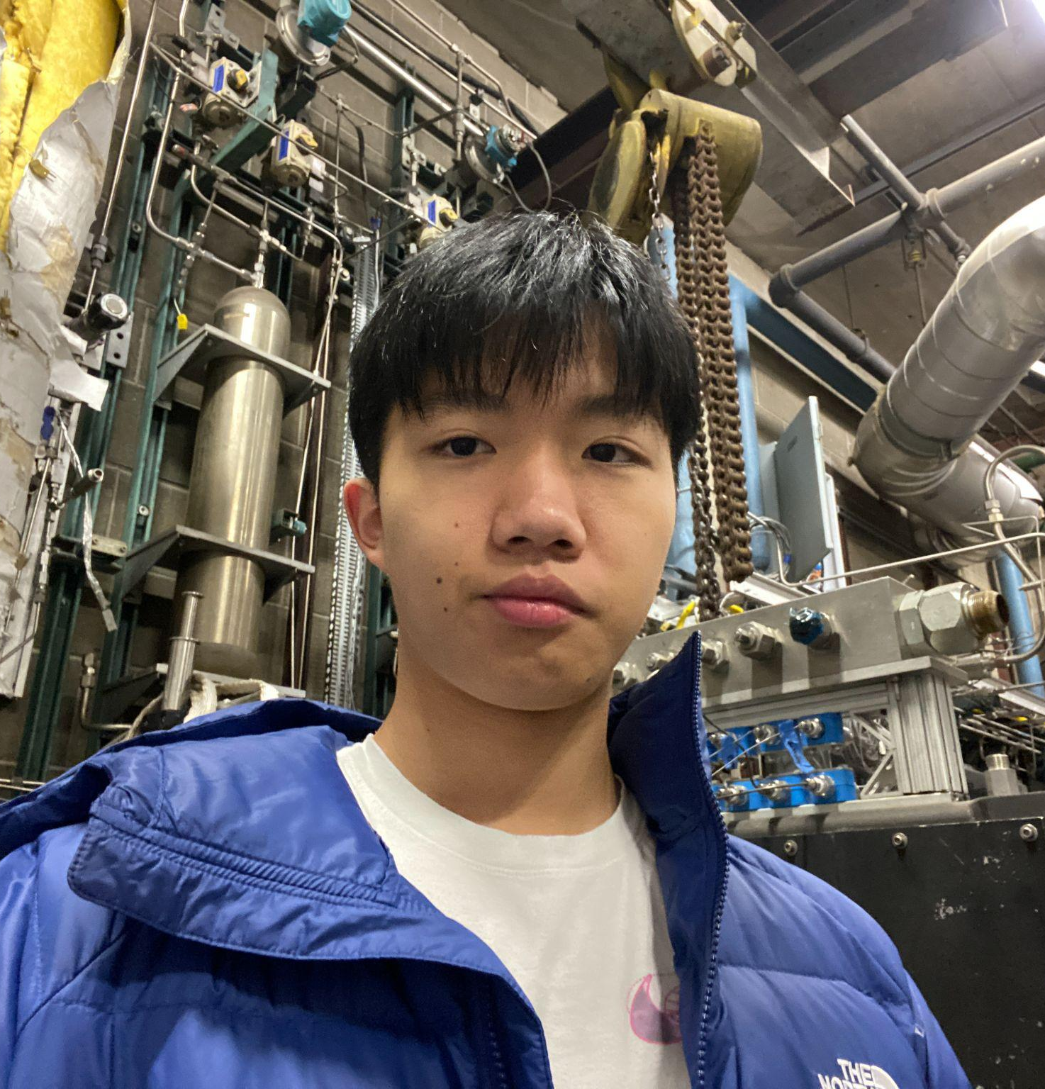
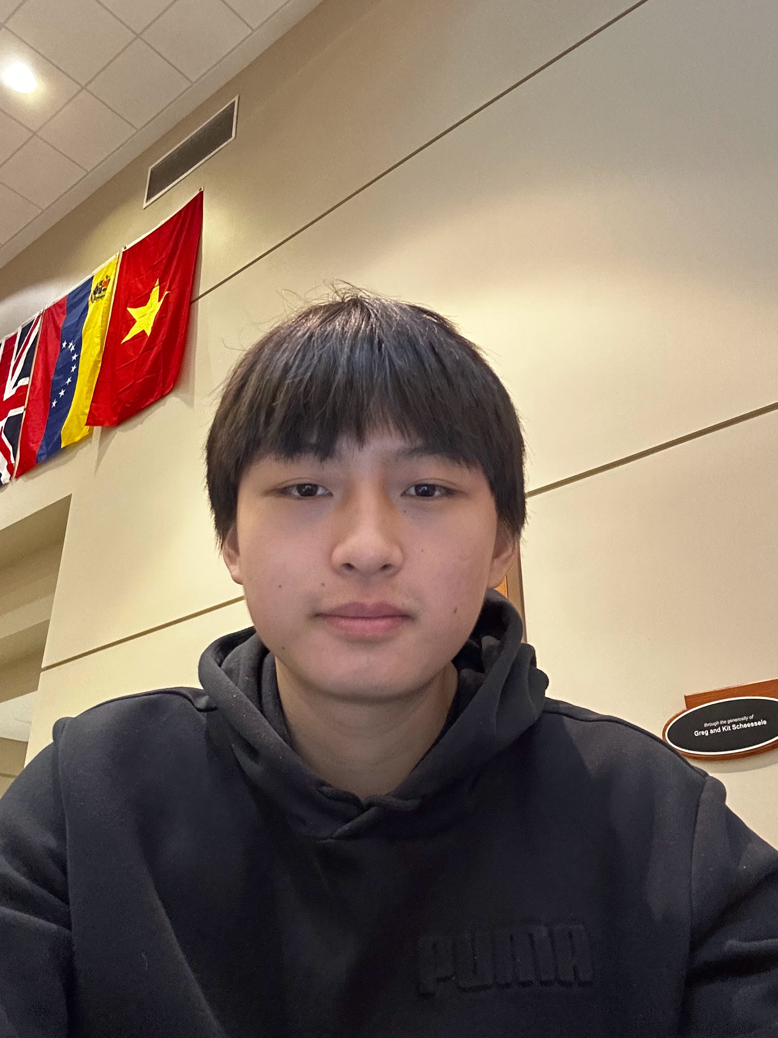


Team Introduction
Andrew Lu
Jiayi Liu
Leo Lesmes
Nhan Do
Freshman
First-Year Engineering
Sophomore
Computer Engineering
Freshman
First-Year Engineering
Freshman
First-Year Engineering

Slide 3
Technical

Slide 4
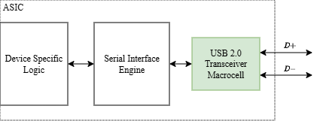

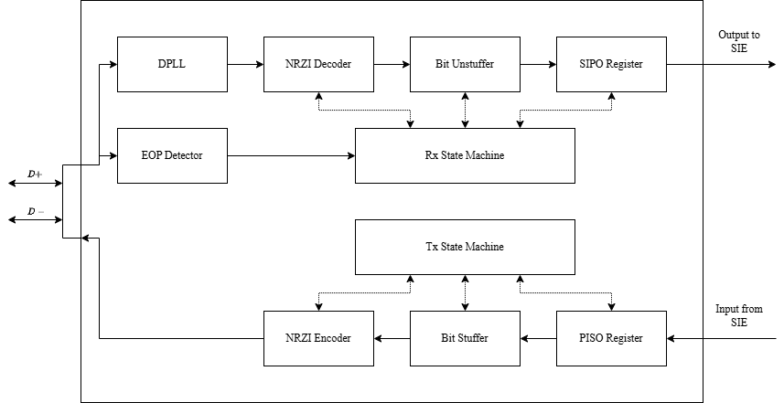
Overview

Slide 5
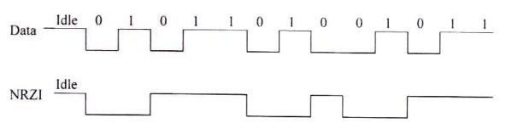
NRZI = Non Return to Zero Inverted
If bit is 1 -> Encoded line stays the same
If bit is 0 -> Encoded line transitions
Encoded when transmitting, decoded when receiving

Slide 6
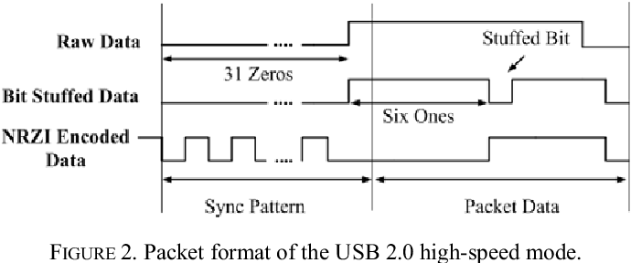
Bit Stuffing
If 6 consecutive bits of 1 are detected in the data line, add a 0 bit
Bit stuffing is needed for transmitting (done before NRZI encoding)
Bit unstuffing is needed for receiving (done after NRZI decoding)

Slide 7
Design
Research and Background Information
USB 2.0 Specifications
NRZI Encoding/Decoding, Bit Stuffing/Unstuffing, etc.
SYNC, EOP, and other data packets
Preliminary RTL Design
Determining what modules needed to be created
Assignment of roles in implementing various modules
Implementation and Testing
Coded modules in SystemVerilog and debugged them with testbenches
This progression allowed us to learn quickly with trial and error

Slide 8
Division of Labor
NRZI encoder and decoder
Bit stuffer and unstuffer
RX/TX state machines
Shift registers
Andrew Lu
Jiayi Liu
Leo Lesmes
Nhan Do
We chose parts of the USB transceiver we wanted to implement
Labor was pretty equal due to our scheduled group meetings that lasted multiple hours
Labor was further distributed for creating the top module and test benches for all of our modules

Slide 9
Timeline
Project Proposal Drafting
Diagramming and Planning
Presentation and Paper Creation
Week 0
Weeks 3-4
Week 8
Weeks 1-2
Weeks 5-7
Research
Coding and Testing
Notes:
Presentation answers 2/2 critical questions about the timeline
What was initial roadmap for completing the project?
In what ways did your team deviate from the roadmap?

Slide 10
Testing and Benchmarks
USB transceiver transmits and receives data as stated in our proposal
Individual modules were tested and verified with testbenches
The full USB transceiver was then tested with predetermined bytes to be transmitted or received
We analyzed the waveform outputs
We confirmed that it correctly decodes and unstuffs the data for receiving as well as stuffs and encodes the data for transmitting

Slide 11
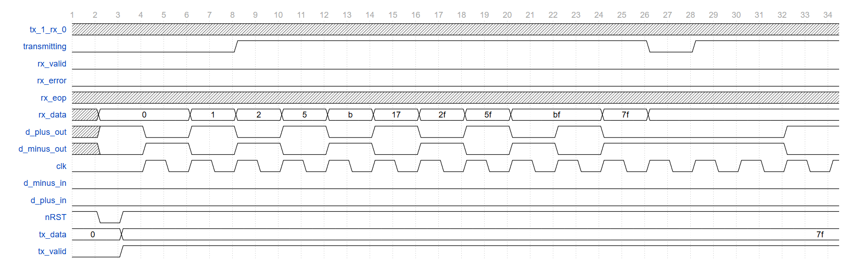
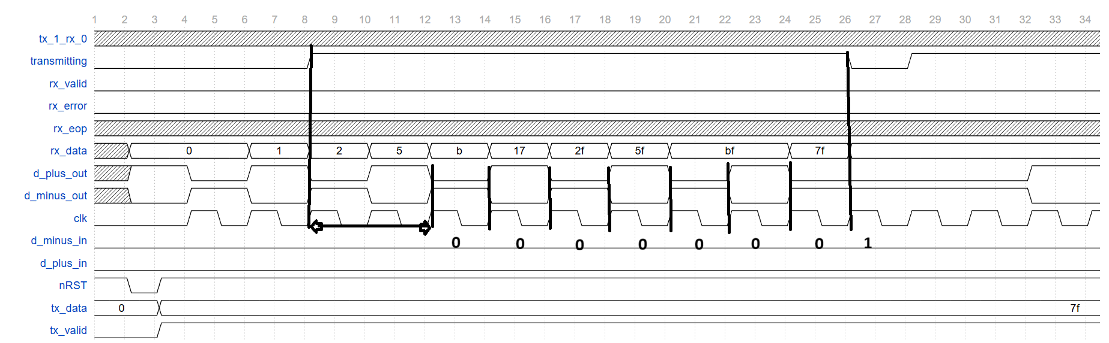
Simulation: Transmitting Data
SYNC simulation
Notes:
Presentation provides comprehensive visual proof of the final results.
Comprehensive results means a video or set of photos/screenshots that show the project's intended operation in enough use cases.

Slide 12
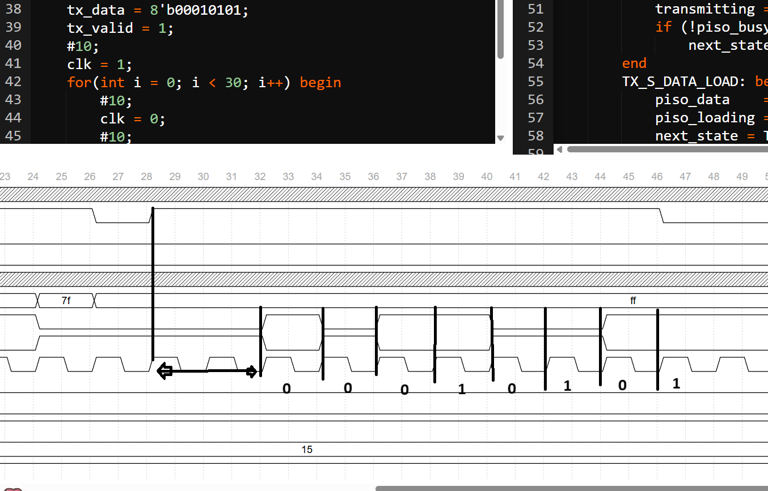
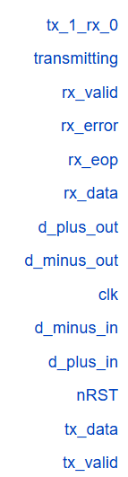
Simulation: Transmitting Data
Test case: 8’b00010101

Slide 13
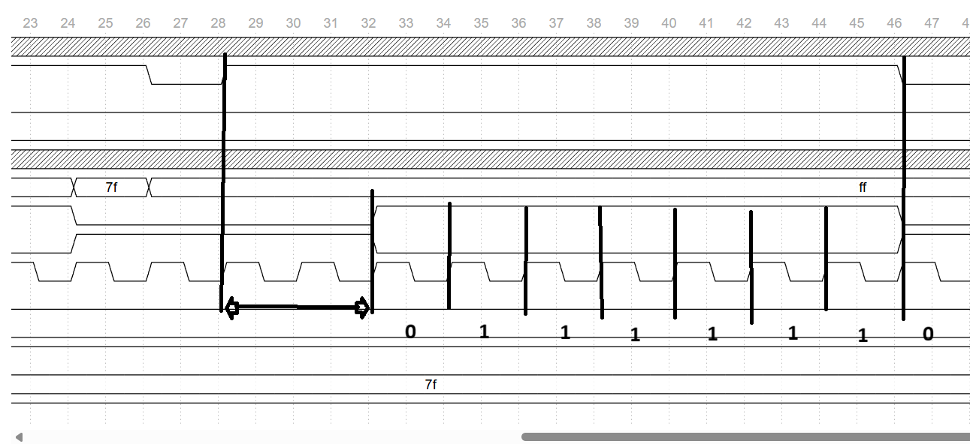
Simulation: Transmitting Data
Test case: 8’b01111111 or 7f

Slide 14
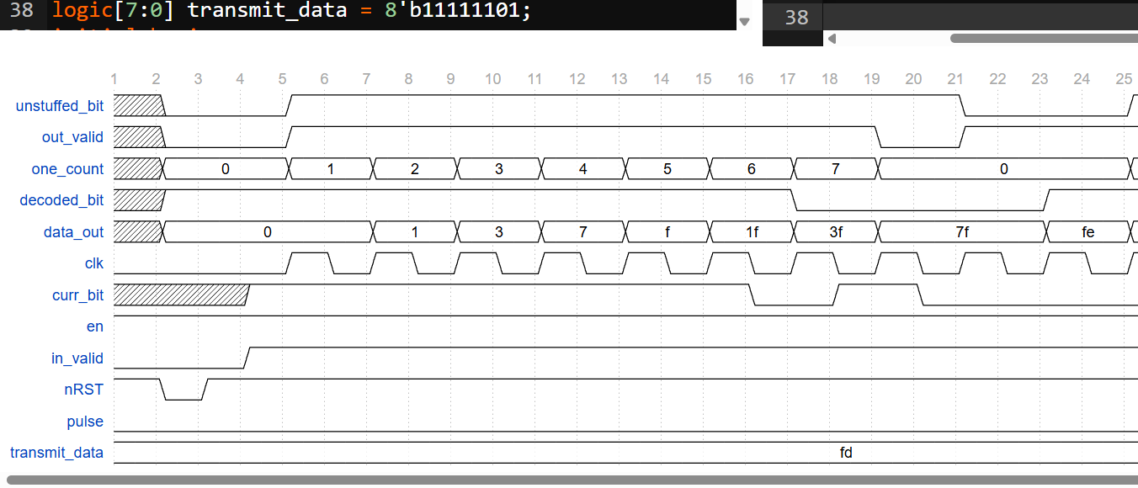
Simulation: Receiving Data
0000_0001 0000_0011 0000_0111 0000_1111 0001_1111 0011_1111 0011_1111 0111_1111 1111_1110
Bit unstuff
Notes:
Presentation provides comprehensive visual proof of the final results.
Comprehensive results means a video or set of photos/screenshots that show the project's intended operation in enough use cases.

Slide 15
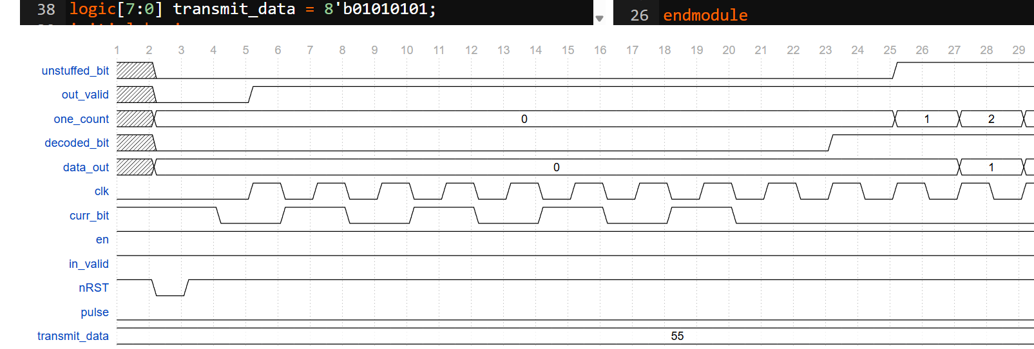
Simulation: Receiving Data
Test case: 01010101 Expected data received: 00000000
Notes:
Presentation provides comprehensive visual proof of the final results.
Comprehensive results means a video or set of photos/screenshots that show the project's intended operation in enough use cases.

Slide 16
Reflection

Slide 17
Reflection
I want to continue learning about digital design.
I want to continue down software or digital design.
I’m very interested in EE, and want to further explore Analog Design.
I want to join digital design team and expand my knowledge about digital peripherals.
Andrew Lu
Jiayi Liu
Leo Lesmes
Nhan Do
Building this from the ground up forced us to apply our digital design skills
We improved at testbench writing
We better understand organizing the communication between modules

Slide 18
Thank You!

